Slide 1
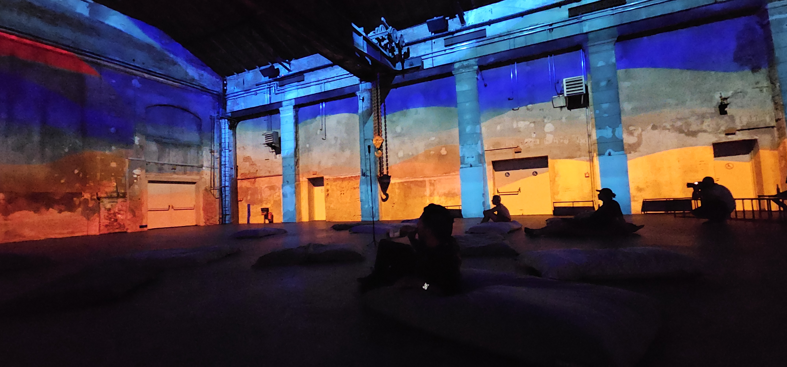
Projection Mapping Façade Mapping

Slide 2
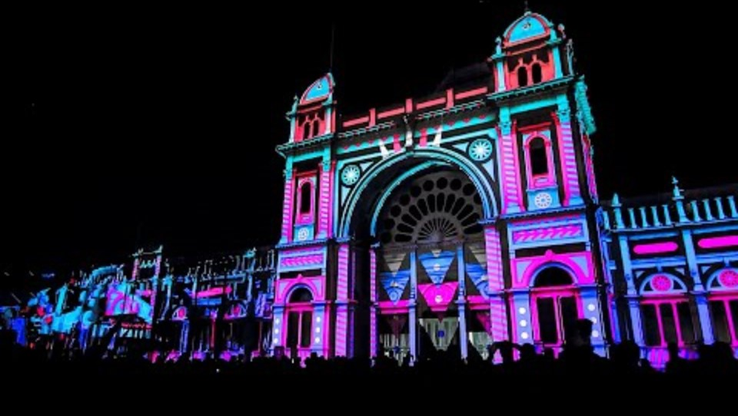

Slide 3
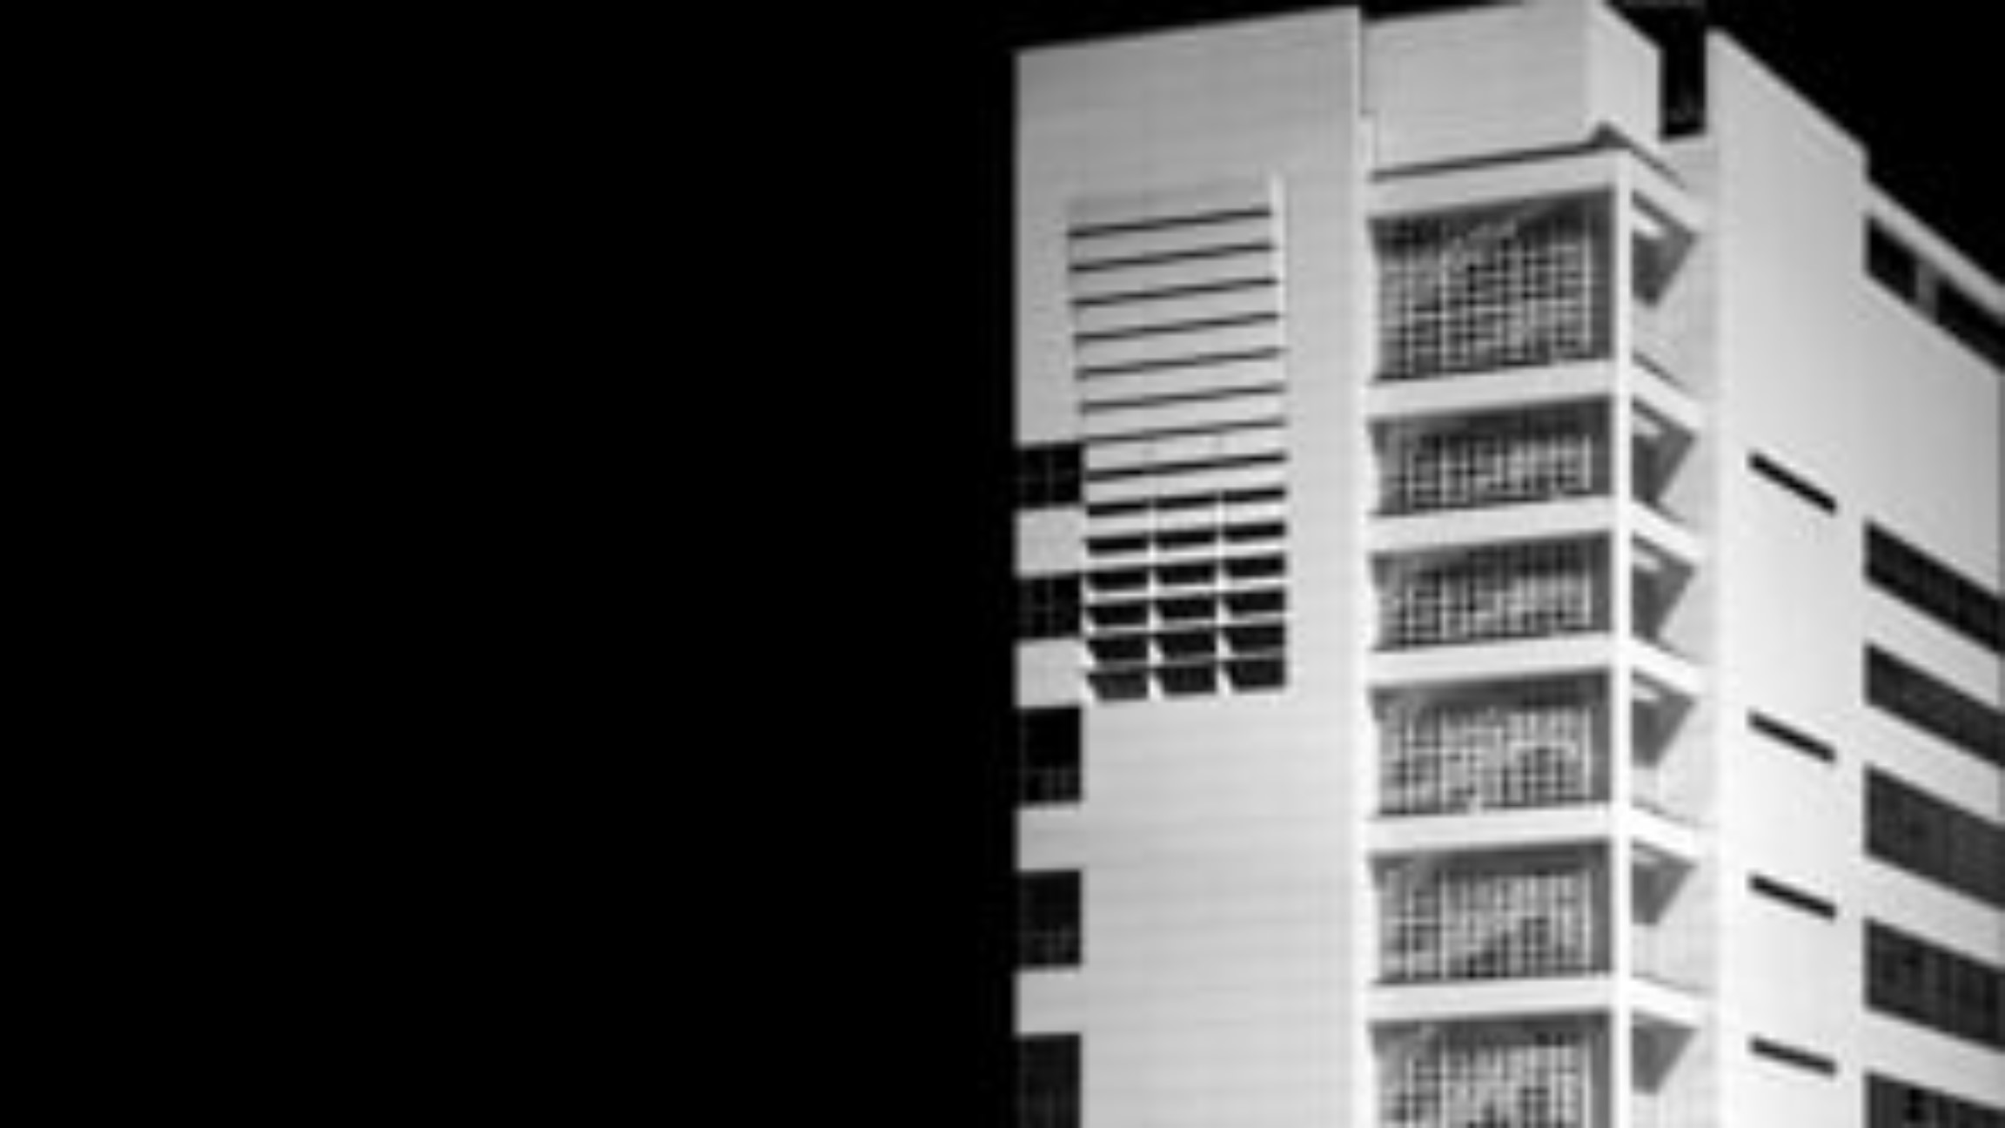

Slide 4
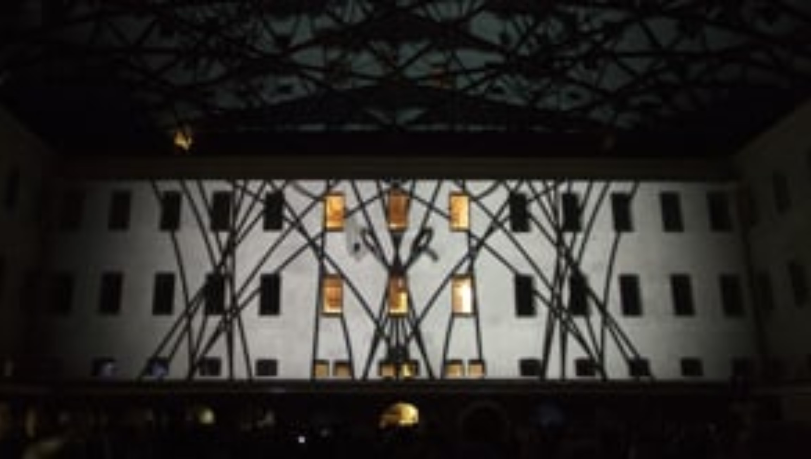
https://vimeo.com/33001491

Slide 6
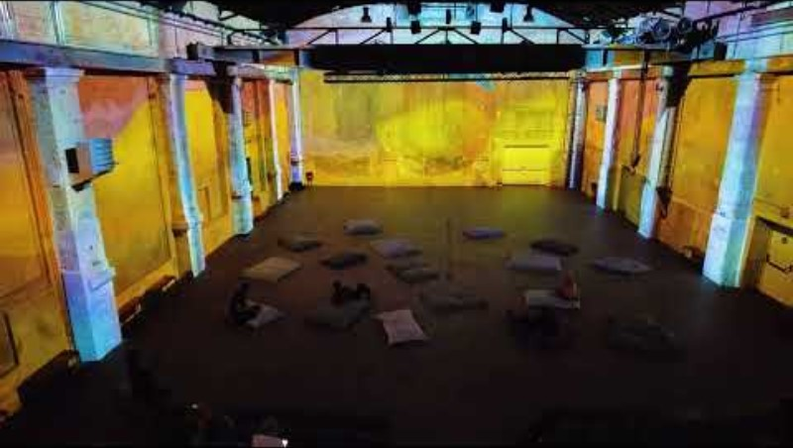

Slide 7

Masks

Slide 8
Mask
a mask defines specific areas of the projection surface where visuals will or won’t be displayed.
Essentially, it acts as a filter that blocks or reveals parts of the image, allowing precise control over where the projection is applied.
This is particularly important for façade mapping, where you may want to project content only onto certain architectural elements (e.g., windows, doors, or specific shapes) while avoiding other areas.

Slide 9
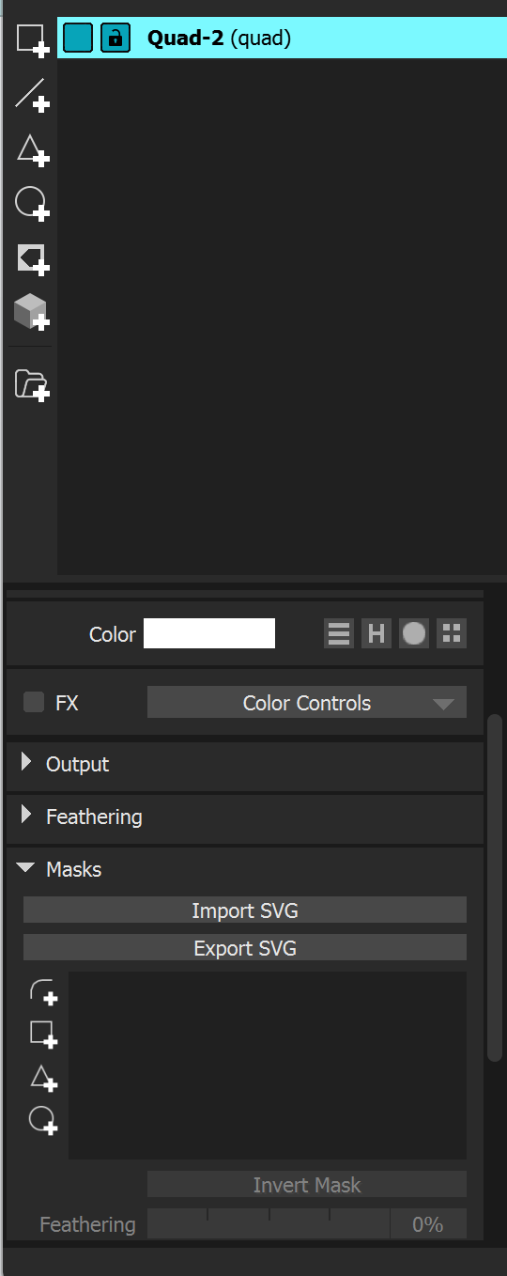
MadMaper
Although you can do it in mad mapper there are better tools.
I use TouchDesigner or After Effects.

Slide 10
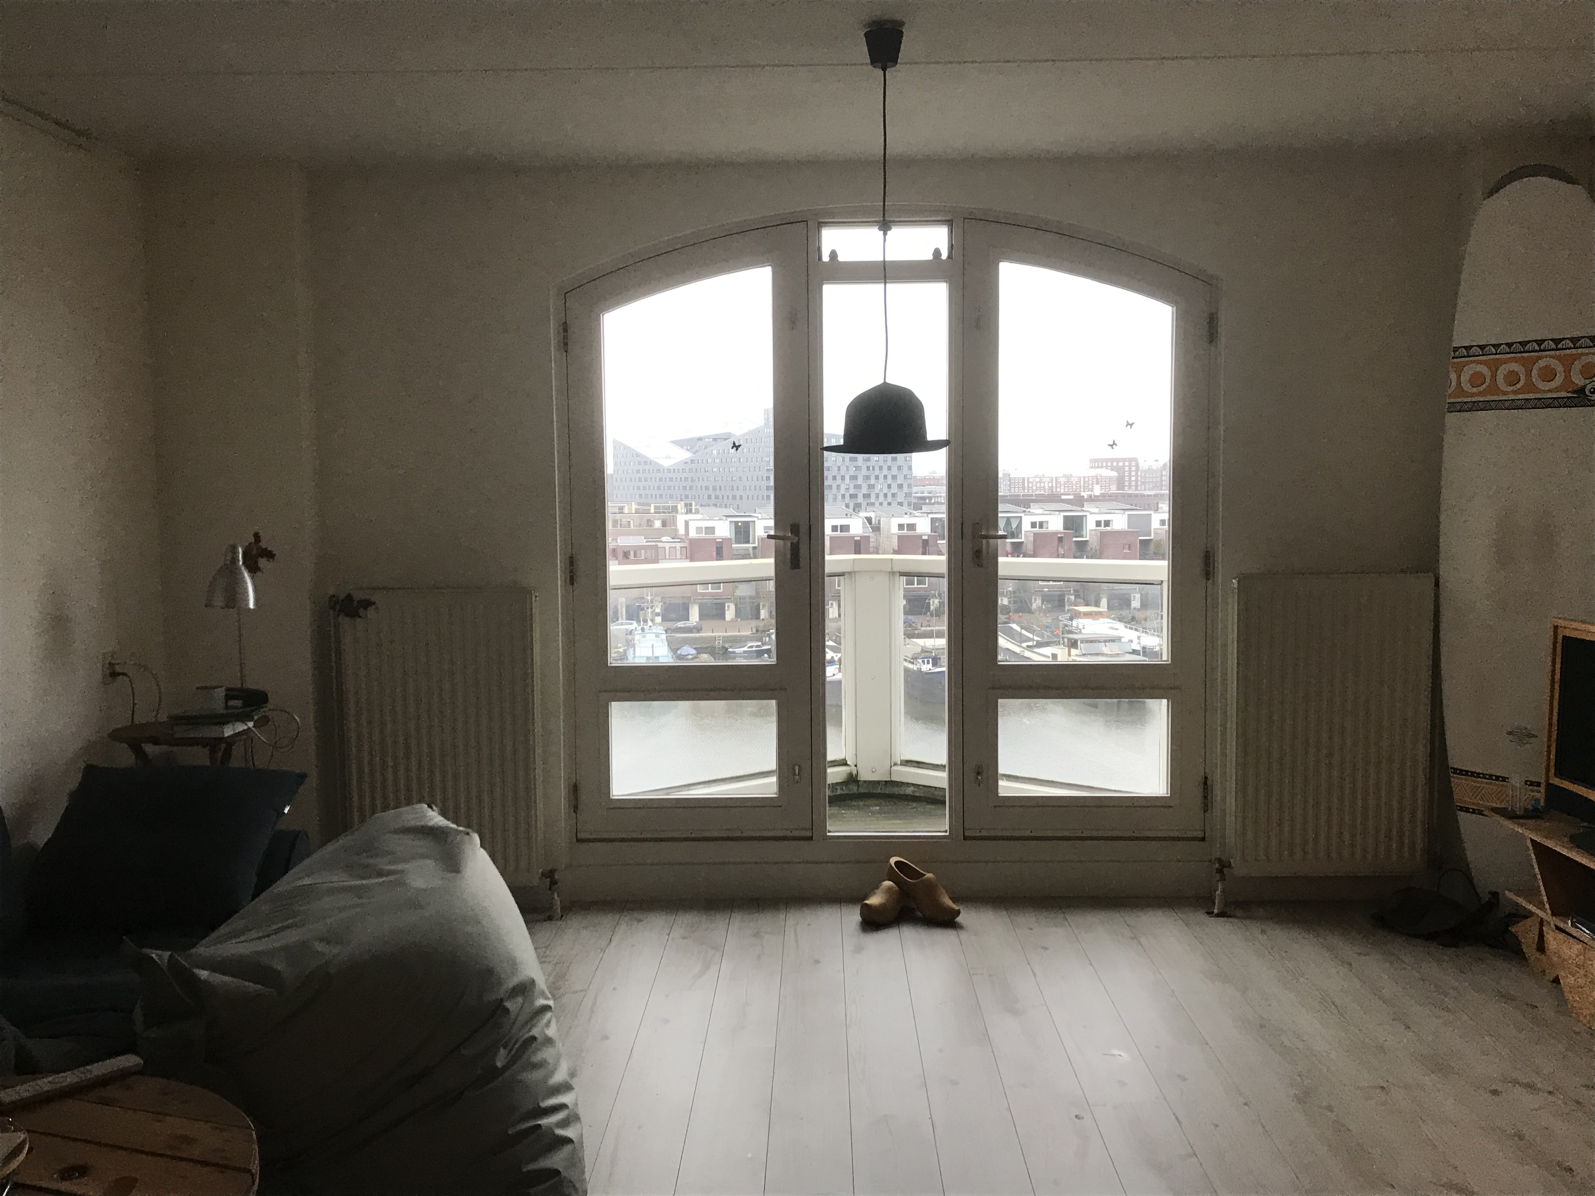
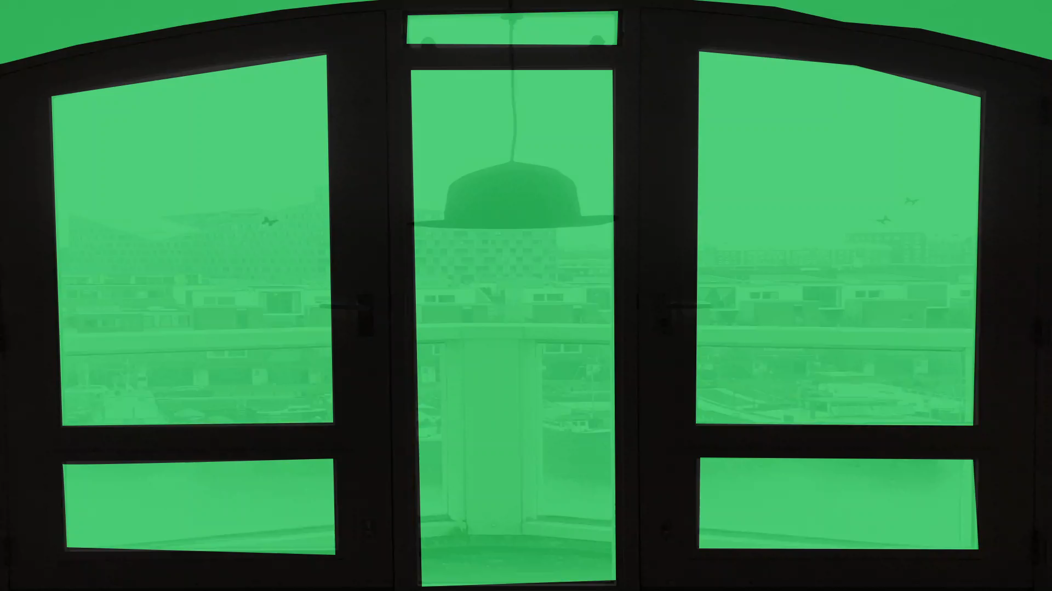

Slide 11

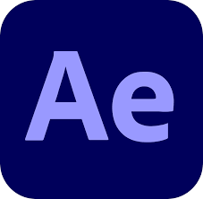
How I did it

Slide 12
Challenge

Slide 13
Challenge 3
Make a 2 to 3-minute projection mapping over the university buildings (mock-ups)
Make sure to bring the architectural elements into your work.
Agree with other groups on sharing projectors and their placing.
Present at 15:15
Extra-mile: use two projectors (or more)

Slide 14
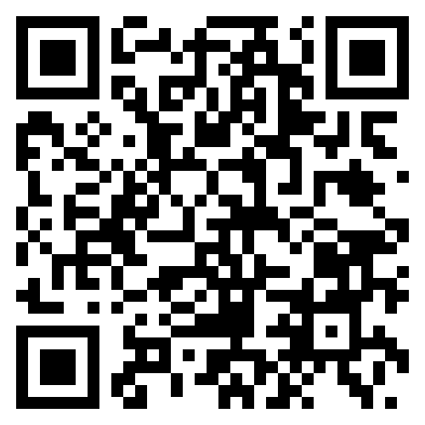
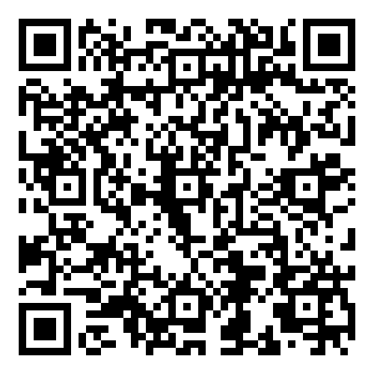
Links
Git repository
AE Saber plugin

Slide 15

Thank you

